Slide 1
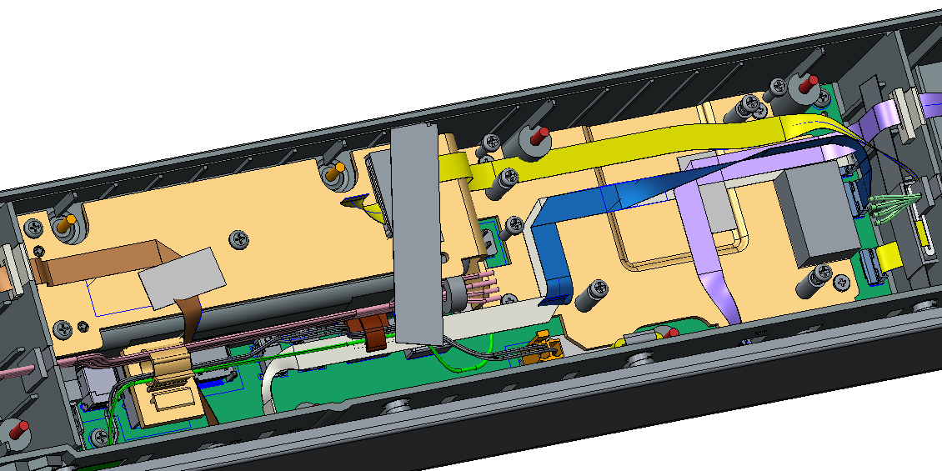
Cable routing of FFC cable
FFC cable MIC
FFC cable button
FFC cable side LED left
FFC cable side LED right
FFC cable LED
We change the cable routing for EMI issues, just like the picture above.

Slide 2
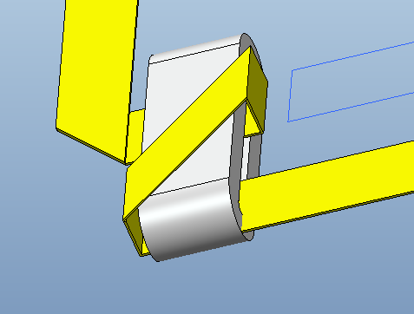
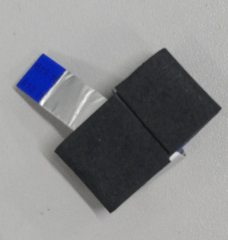
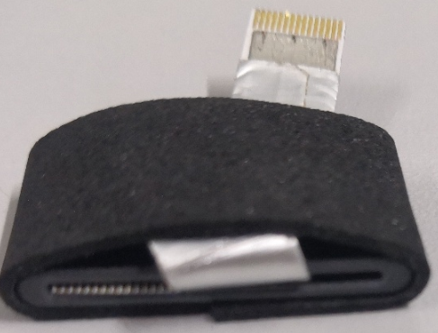
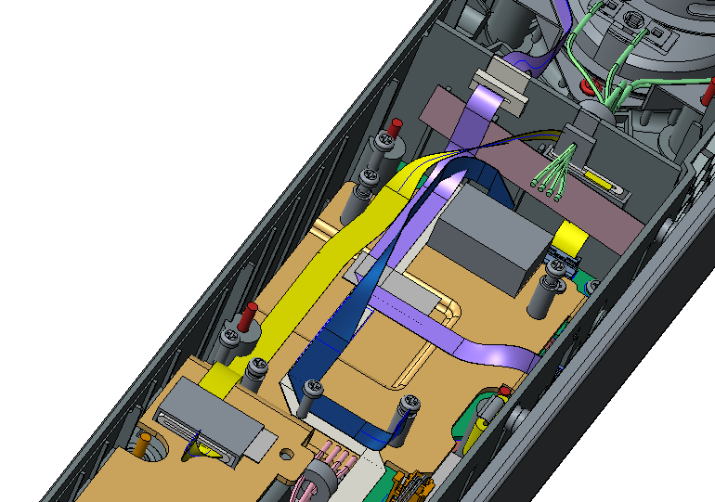
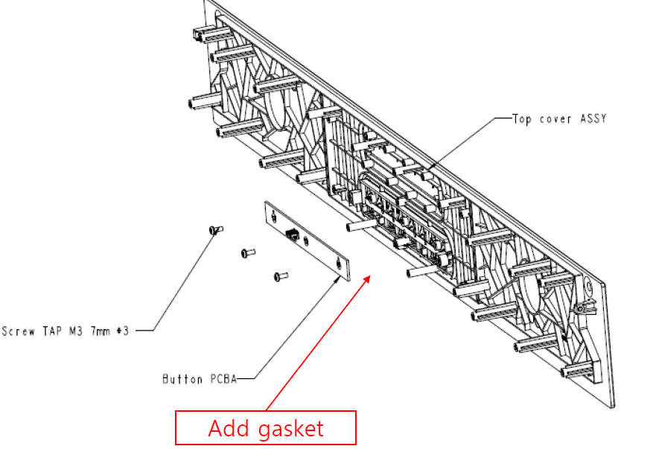
Sponge_Ferrite Core (MIC FFC cable)
Paste the sponge on the Ferrite core, and then paste the core on the housing
MIC FFC Cable routing with Ferrite Core
Sponge_Ferrite Core
Acetic tape
Sponge Button key
ALT requested to add gasket between button key and button board, so we made a list of this.

Slide 3
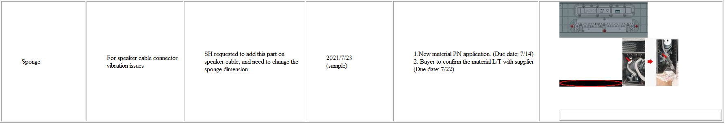
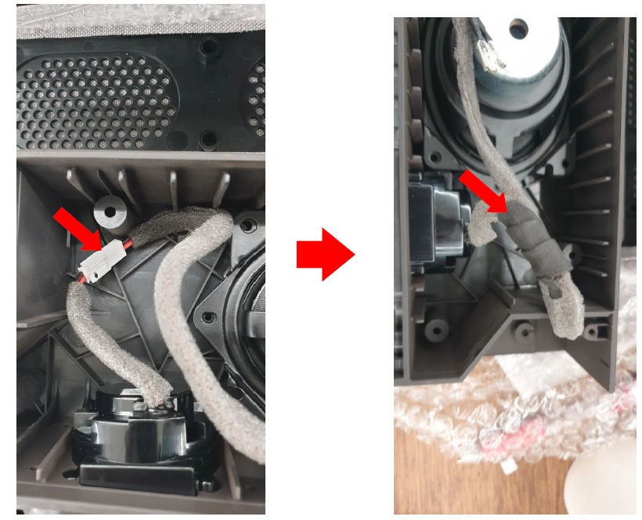
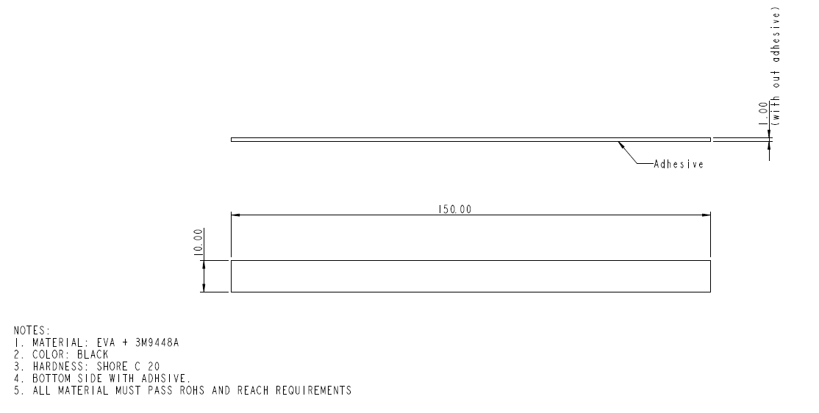
Sponge (For speaker cable connector vibration issues)
Sponge spec
The length of 484.00422.005(10x300x1mm) used in each speaker connector is 150mm (our factory need to cut it in half for each connector), So we add this sponge(10x150x1mm, Qty:2 pcs ) for MP that the factory don't need to cut for the last 0.5pcs.

Slide 4
Assembly issues from factory
05. The T1 samples has no any locate pin, factory is worried that the SoC board will be out of position when locking the screws. So factory suggest to add tow locate pins on bottom cover.
12. As discussed before, GASKET_A & GASKET_B which pasted on the BRACKET SIDE LED will paste on the bracket by vendor. Did you inform that to vendor?
15. It’s difficult to assemble because the pin is very tight.

Slide 5
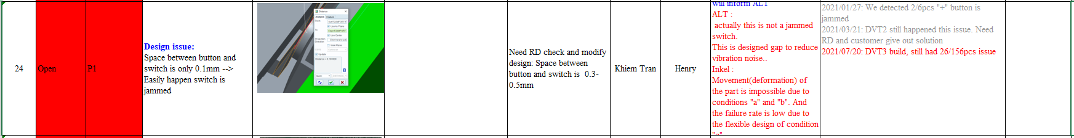
Assembly issues from factory
23. About GASKET CASE TOP (10x300mm), our factory need to cut for the last 0.5 pcs, will you update the dimension?
24. The button is warpage and we can’t touch the button, is any update of this issues?
25. Our factory suggest to add protective film on the housing or change the surface treatment.

Slide 6
Assembly issues from factory
32. The screw hole of side LED board is damaged used screw M3*10mm with torque 6~6.6kgf*cm. Can we change the torque to 3.5kgf*cm for side LED board?
33. The screw boss is damaged used screw M3*7mm with torque 3kgf*cm, and it’s OK used screw M3*8mm with torque 3.5kgf*cm, please deepen the Green Point 1mm to match the screw M3*8mm. Or we need to arrange to separating the SOC board screws driving to two stations.

